Slide 1

Job Board Lite
Bhargav Veerabommala Associate Engineer

Slide 2

Personal Background
•B.Techin Computer Science and Engineering
•Skilled in full-stack development: Python, Java, Spring Boot, JavaScript, Angular, React.js
•Final-year project on deep learning (CNN) Seeking roles in ML, Data Science,

Slide 3
Key Learnings from HTD Program
•Core Java, OOPs, multi-threading, exception handling, collections
•JUnit testing, Git, Agile tracking with Jira
•SQL operations with JDBC, MySQL, and SQL Server
•Spring Boot fundamentals, React for full-stack development Built and deployed full-stack capstone project

Slide 4

Project Overview
•Job Board Lite: Web app for searching and applying to jobs
•Features: Search Jobs, job listing, job details, apply form
•Backend:Spring Boot | Frontend: React.js

Slide 5
Technology Stack
•Backend: Java 17, Spring Boot 3.4.5, Spring REST, JPA, Maven/ Gradle, MySQL
•Frontend: React 19, JavaScript (ES6+), Axios/Fetch, React Router, CSS
•Tools: Postman, npm, Git, Jira, VS Code/ IntelliJ

Slide 6

Development Steps
Set up Spring Boot backend with REST APIs and MySQL
Create React frontend with routing and reusable components
•Integrate frontend with backend using Fetch/ Axios
•Style components with Bootstrap.

Slide 7
Challenges Faced
•CORS issues during frontend-backend integration
•Data format mismatches between frontend and backend
•SQL performance tuning for user-specific queries
•Ensuring smooth API communication

Slide 8
Future Scope
•Add user registration and login with AuthGuard
•Resume upload and storage (link format)
•Email notifications after job application
•Recruiter module for posting and managing jobs

Slide 9
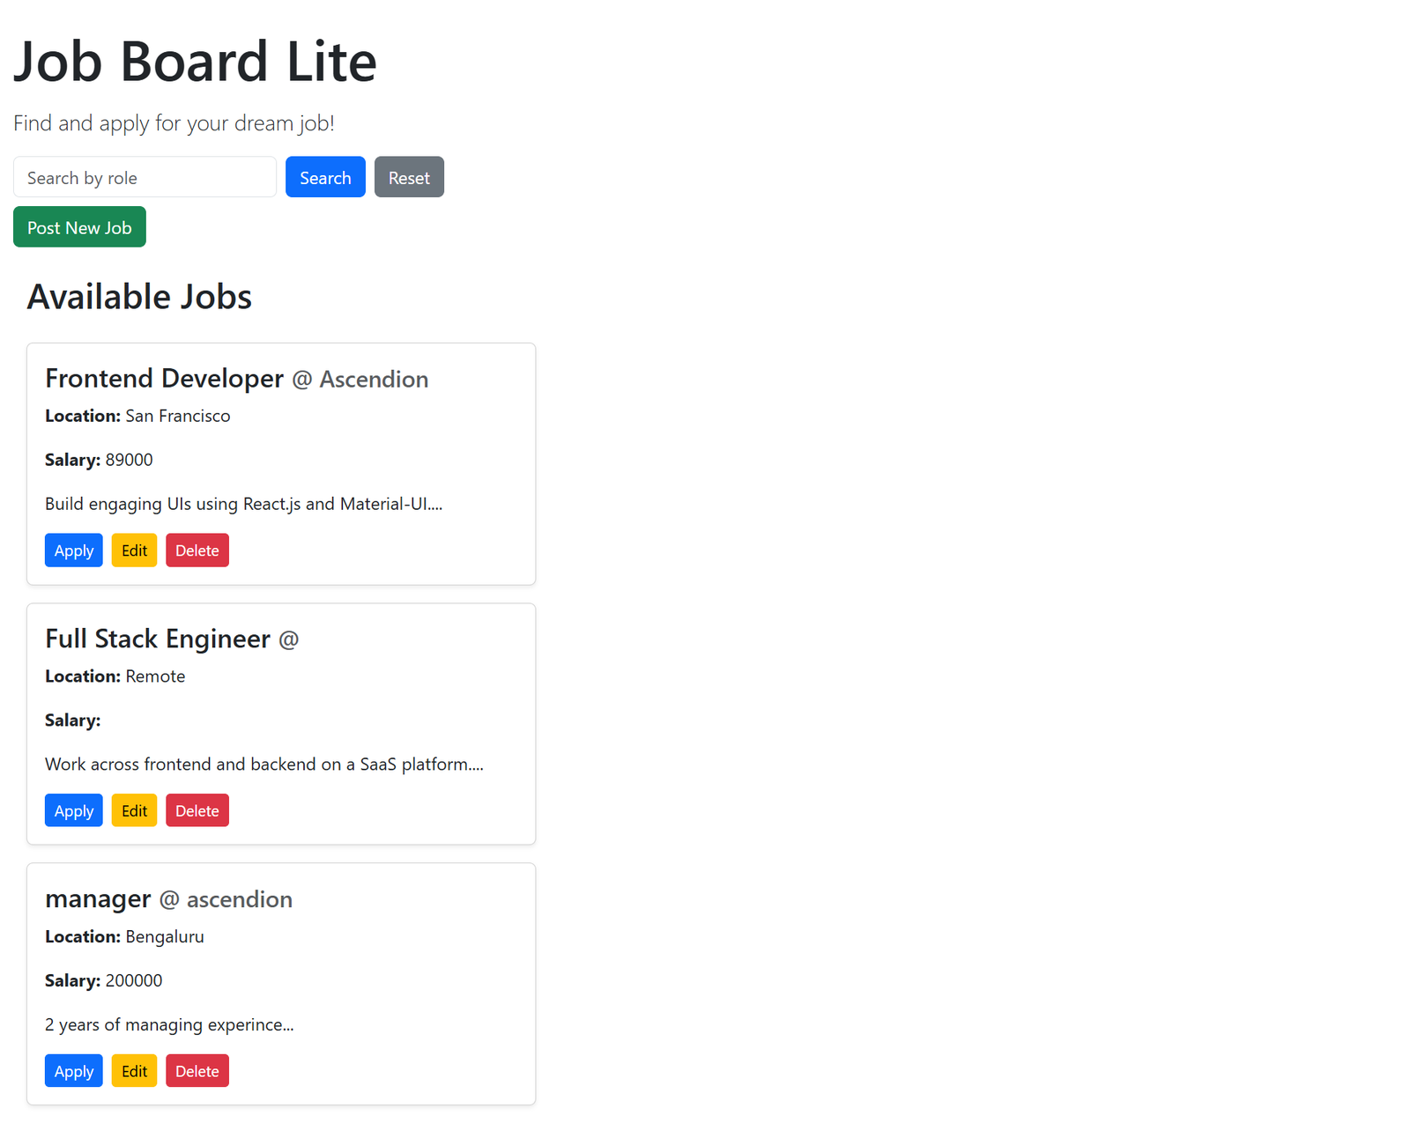
Project Screenshots

Slide 10
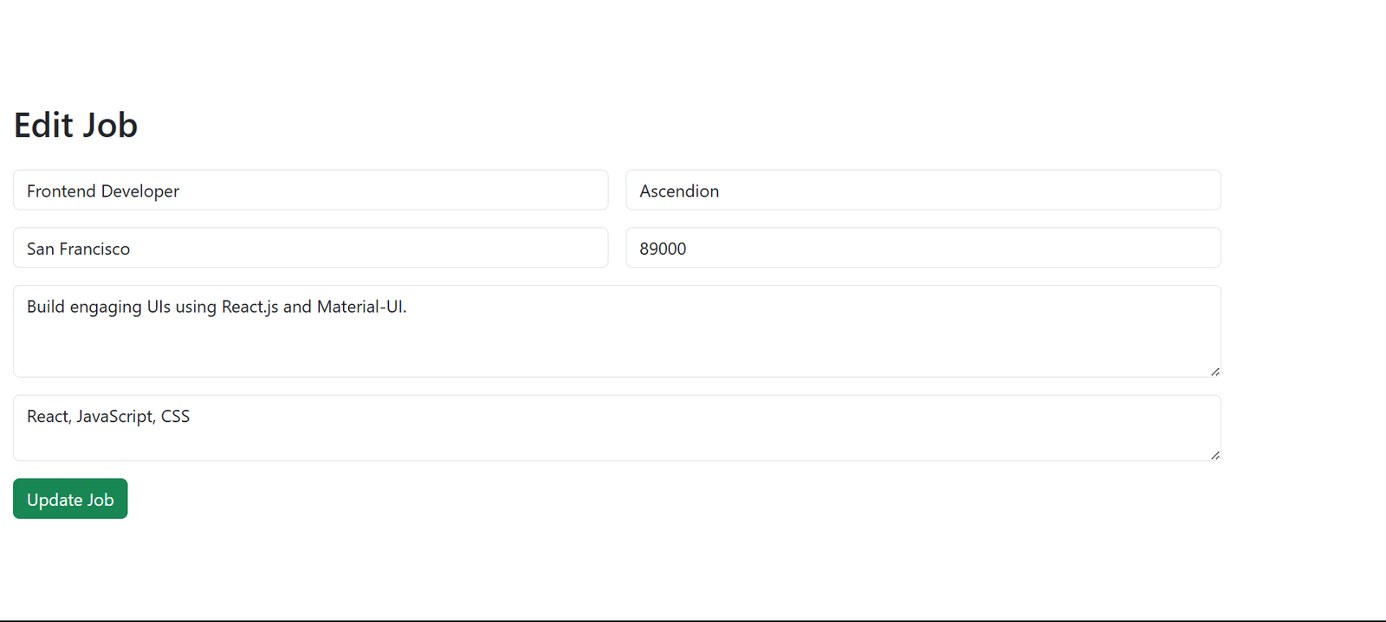
Project Screenshots

Slide 11
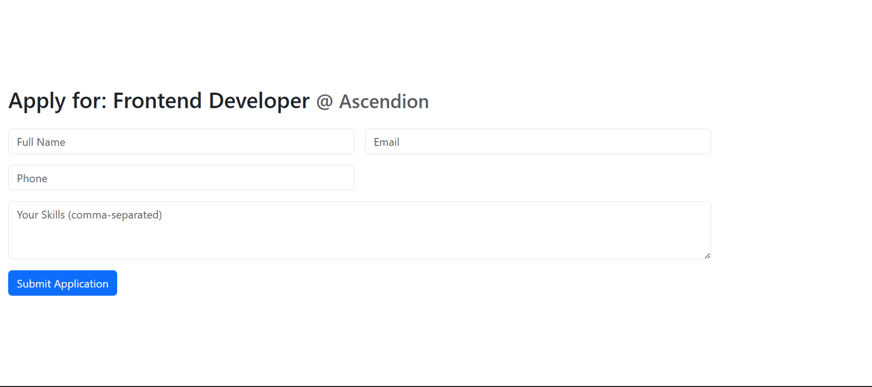
Project Screenshots

Slide 12
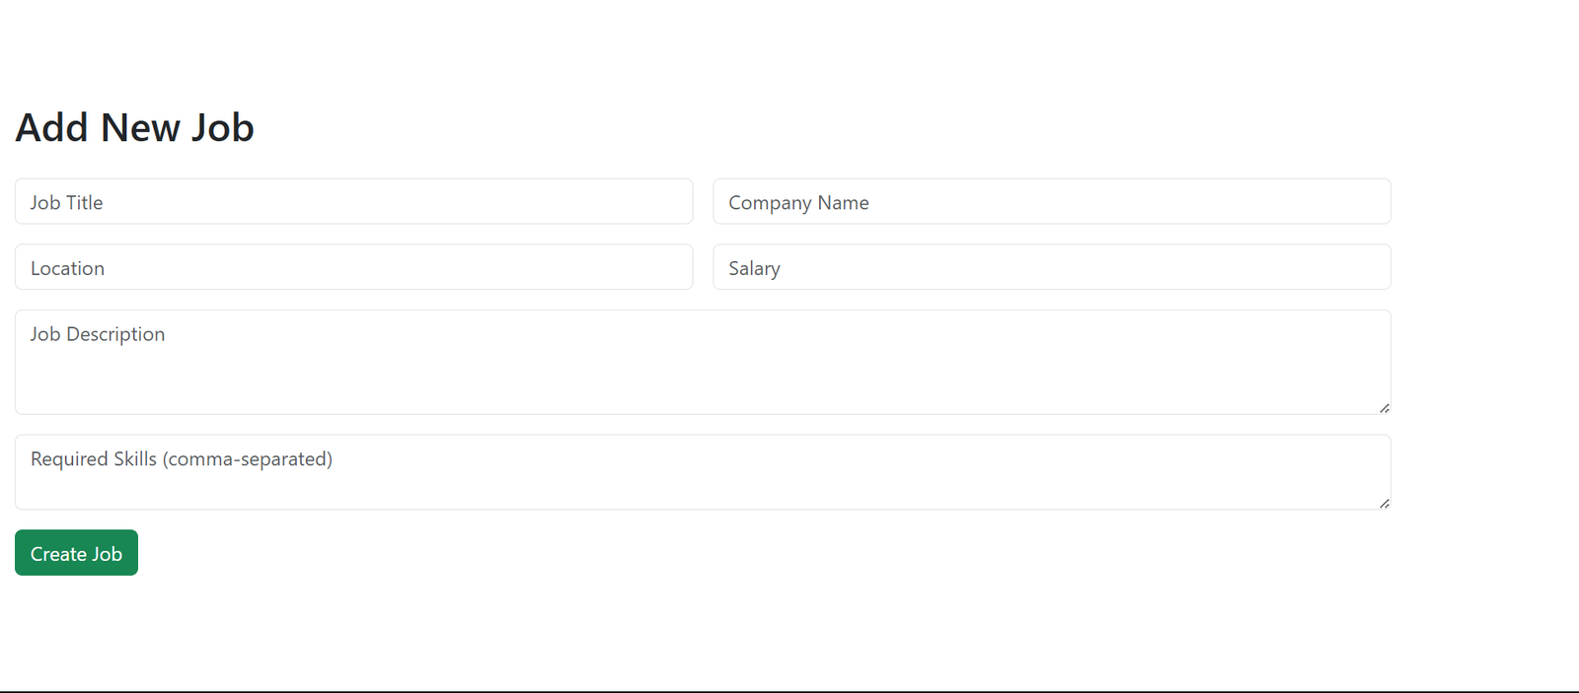
Project Screenshots

Slide 13
Conclusion
•Developed a minimal job board using Spring Boot and React
•Gained real-world experience in full-stack development
•Integrated frontend/backend with clean design and APIs

Slide 14
References
•Spring Boot: https://spring.io/projects/spring-boot
•React: https://react.dev/learn
•MDN Fetch API: https://developer.mozilla.org/en-US/docs/Web/API/Fetch_API

Slide 15
Thank You
Questions & Discussion

